Slide 1

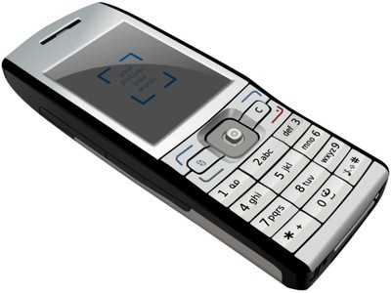
Accurate, Low Energy Trajectory Mapping For Mobile Phones
Arvind Thiagarajan, Lenin Ravindranath,
Hari Balakrishnan, Sam Madden, Lewis Girod
MIT CSAIL
Notes:
Hello everyone, my name is Arvind. Today I’m going to talk about a system called Ctrack. The goal of the system is to estimate
The trajectory or track of a mobile device. What is different from Ctrack compared to previous approaches to the problem is
that it is an extreme point at the low-energy end of the scale: it consumes close to zero energy on phones (since it uses GSM)
And still achieves reasonably good accuracy for finding tracks.

Slide 2
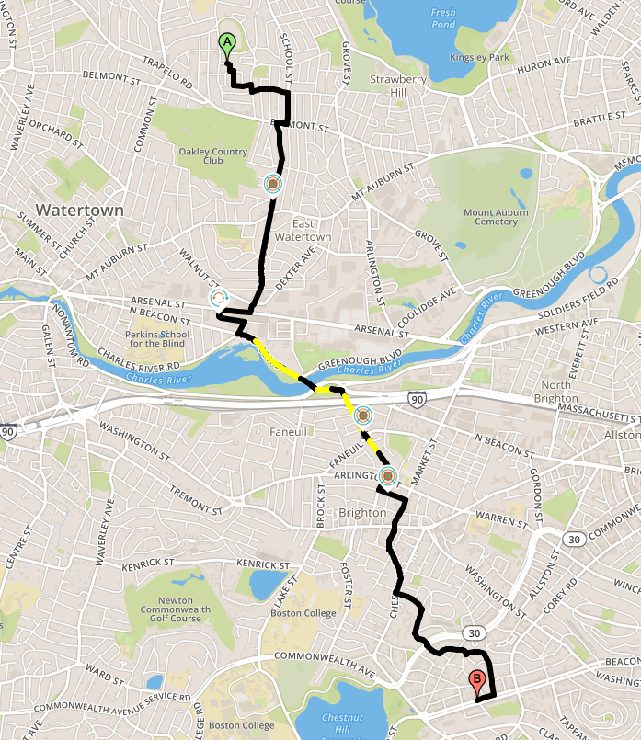
Goal
Find the trajectory i.e. sequence of locations visited by a mobile device
Applications need to find path both accurately and energy-efficiently
Notes:
The abstract problem I’m going to talk about is to find the sequence of locations visited by a mobile phone. When I say location here, it could mean a sequence of roads or
Places visited outdoors, or it could be a sequence of rooms indoors. This problem is non-trivial because we want to do it accurately but energy-efficiently at the same time,
Today, there is actually no known position sensor on a mobile phone that is both accurate and energy-efficient.

Slide 3
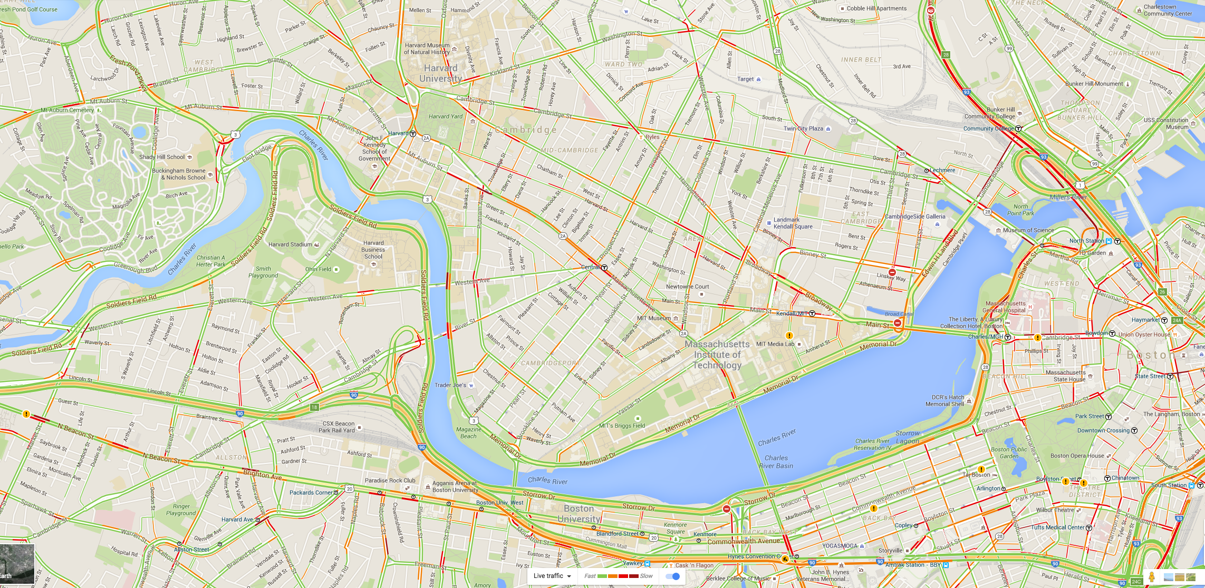
Traffic Estimation

Slide 4
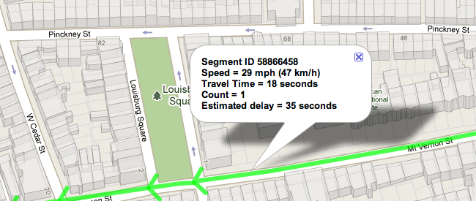



Crowdsourced Data
Trajectory Finding
Collect Data
From Phones
Share traffic info
with other phones/cars
For route planning
Battery dies in ~6 hours if monitoring with GPS
Notes:
This slide shows an example of a continuous monitoring application that needs to find trajectories. This is a snapshot
of the architecture of iCartel, a traffic prediction system we have built here at MIT. iCartel crowd-sources location data
from individual users’ phones with the goal of measuring and predicting traffic delays or travel times on individual
Road segments of the network. For this, we need to be able to find the trajectory of the phone accurately down to
The level of road segments and the time spent on each road segment. The travel times are sent back to the server
And then shared with other users of the phone application, as well as used for intelligent route planning.
The problem with using GPS in a scenario like this is that the phone battery simply dies in a few hours or less than
a day if running the application, which turns off people from using the application. So the question we ask is:
Is it possible to reduce this significantly (by an order of magnitude) while still finding accurate travel times?
There are also many other examples of trajectory monitoring applications. Fitness applications on the market allow
You to map a bike ride or a jog, and all of these today rely on GPS. Battery drain is a common complaint.

Slide 5
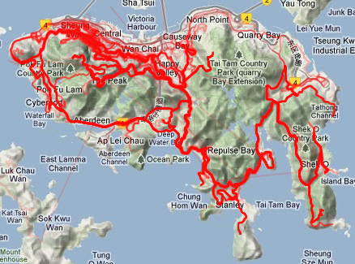
Bike Routes
http://www.jonathanokeeffe.com/strava/multi-ride-mapper/

Slide 6
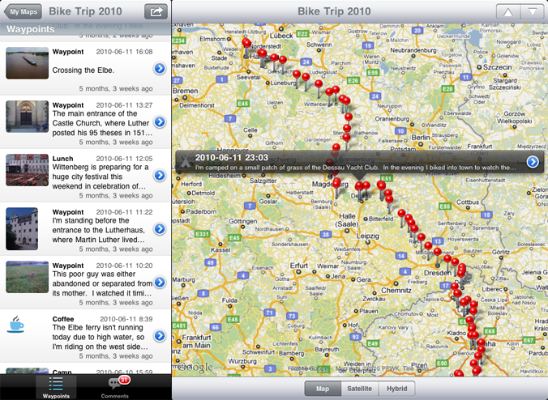
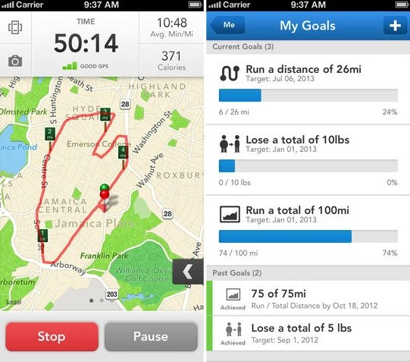
TrackMyTour iPhone App:
Allows users to keep track of
their trips and annotate them
Running
Notes:
For example, this screenshot shows an example from an app called TrackMyTour
For the iphone – it tracks my path when I’m traveling and allows me to label and annotate it,
Which is nice.

Slide 7
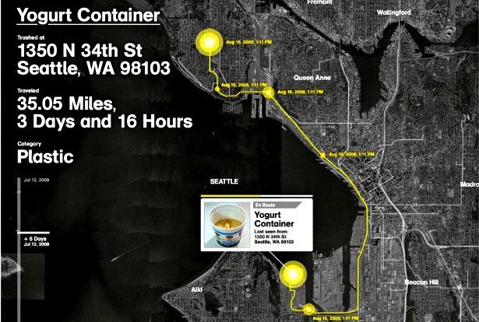
Trash Track

Slide 8
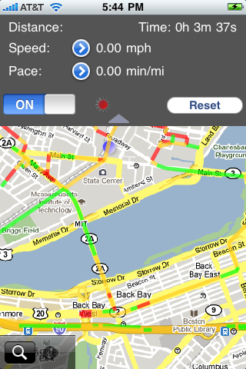
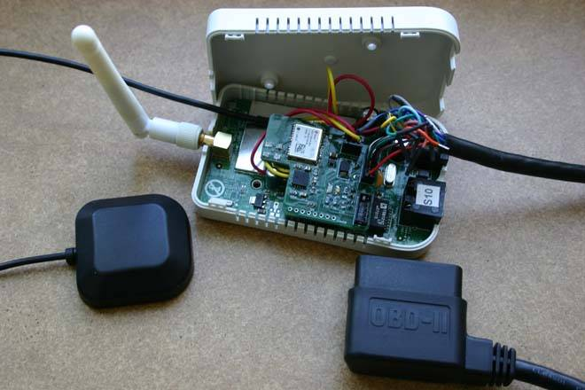
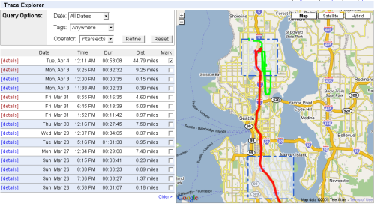
Context: CarTel Project
Crowdsource tracks to estimate
traffic on road segments

Slide 9
Limitation of GPS: Energy
GPS signals are energy-intensive to acquire & process
Frequent GPS sampling drains battery fast
6 hrs on iPhone 3GS vs 18 hrs w/o GPS (dim screen)
Android G1 phone: 6-8 hours with 1 Hz GPS
Notes:
Continuous GPS sampling ends up draining a phone’s battery quickly
Within 6-8 hours: G1, Android, iPhone 3G, iPhone
Undesirable for users, makes them reluctant to use the app

Slide 10
Approach: Use low-power sensors
GPS
Close to standby energy (< 1 mW extra energy)
Much more energy efficient than GPS/WiFi (400, 100 mW)
Relative
Energy
consumption
Wi-Fi
Cellular
5-10m
75m
300m
Raw accuracy of position samples
Notes:
Several approaches to trade off accuracy for higher battery life.
Subsampling GPS, or using radio localization.
Explain how radio localization techniques work here.

Slide 11
Outline
Prior work
Intermittent GPS (Microsoft – Krumm)
Wi-Fi (VTrack – from same group as CTrack – CarTel project)
CTrack paper
Cellular fingerprints
Better energy
Accuracy?

Slide 12
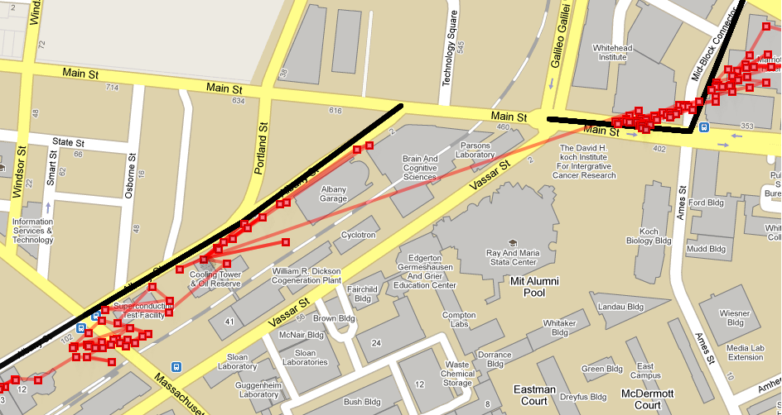
Noisy Data (Wi-Fi example)
Outlier
The closest road to a position
sample is not where it originally came from
Future
Previous
Exploit both previous and future location information
Don’t overly weight any one location sample
Find a continuous (unbroken) sequence of roads
Notes:
First let’s talk about handling noisy data and not worry about infrequent data
for now. A key challenge in map-matching noisy data is that the closest road to a
position sample is usually not the one it came from originally. So it’s not enough
To just use local information from map-matching. We need to use previous history
And potentially future history.
In the example here, it becomes clear that the points in the blue circle come from the
Black line only after looking at previous and future samples. Ideally we need as many as
possible.
Two other requirements: don’t overly weight any one location sample (because it could be an outlier).
Third: produce a continuous sequence of roads so that we can find meaningful travel times.

Slide 13
Solution: Hidden Markov Model
Maps noisy observations (coordinates) to hidden states (underlying road segments)
Noisy (Lat,Lon)
(Observable)
p_{i}
p_{i+1}
Emission Score
E(p_{i},S_{i})
Road Segment
(Hidden State)
S_{i}
S_{i+1}
Transition Score
T(S_{i,} S_{i+1})
Dynamic Program Finds Best State Sequence (cf. Viterbi)
“Best” => Max Product of Emission and Transition Scores
Notes:
We use a hidden markov model to solve this problem. For those of you who aren’t familiar, a quick introduction.
A HMM ….
In our example…
The nice thing is that a HMM satisfies all the three properties mentioned earlier.
It weights both past and future information if available, it doesn’t overly weight
Any one location sample or use purely local information for matching, and it
It guaranteed to find a continuous output sequence, by definition.

Slide 14
Emission Score
Emission Score E(p_{i},S_{i}) = e^{-d2/σ2}sensor
Intuition: pts closer to a segment are more likely to come from it
σ_{sensor} depends on GPS/WiFi/Cellular
p_{i}
d
S_{i}
Notes:
Emission and transition scores are an important ingredient. We use a simple
Error model in Vtrack which we have found works well. This doesn’t necessarily
Mean that errors have to be Gaussian, as long as they fall off with distance we’re ok.
The important part of the design is the transition score. We use a 0-1 transition constraint
Instead of a transition probability. Explain why….
Speed constraint turns out to be very important as we show…

Slide 15
Transition Score
Transition Score T(S_{i},S_{i+1})
0 if segments are not adjacent or not enough time has been spent on S_{i}
1 if segments are adjacent and enough time has been spent on S_{i}
Speed constraint is essential: because algorithm jumps around and follows noise in the input data without it
Decreases error significantly
S_{i}
S_{i+1}
Notes:
Emission and transition scores are an important ingredient. We use a simple
Error model in Vtrack which we have found works well. This doesn’t necessarily
Mean that errors have to be Gaussian, as long as they fall off with distance we’re ok.
The important part of the design is the transition score. We use a 0-1 transition constraint
Instead of a transition probability. Explain why….
Speed constraint turns out to be very important as we show…

Slide 16
VTrack In Action
p1
p2
S2
S1
p3
S3
p4
p4
p1
p3
p1
p2
p4
S1 S1 S3 S3 is
most likely match
S1
S1
S1
S1
S2
S2
S2
S2
S1 S2 S3 S3 has
score 0, isn’t
permitted
(speed constraint)
S3
S3
S3
S3
S1
S2
S3
S3
Notes:
Walk the reader through the example. Show that nearest neighbour would get the answer wrong, but Vtrack gets it right.

Slide 17
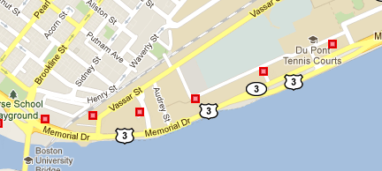
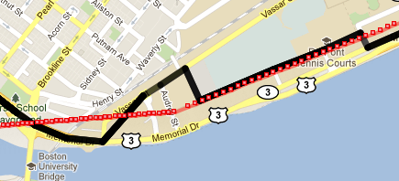
Handling Gaps: Interpolation
VTrack’s HMM maps input to output samples one-to-one
We need frequent (1 Hz) input because we want output to be continuous (so we can enforce adjacency constraint)
Interpolate gaps, then run HMM (linear interpolation)
Notes:
HMM doesn’t deal with outages but needs frequent input because it assumes
A one-to-one mapping from input to output states and output must be continuous.
So need at least one input point per road segment, however small.
can fix this doing interpolation, snap them to the grid. What interpolation
To use? Linear turns out to work well for short gaps, as we shall show.
There are cases where shortest paths may be better, but on average
It doesn’t help in our data set, and it’s slower to run (one SP per interpolation).

Slide 18
CTrack Problem Statement
Can we develop techniques to process cellular signal information to produce accurate trajectories?
How accurate?

Slide 19
CTrack: Accurate Trajectory Mapping with Inaccurate Cellular Signals
Consumes no extra energy
New techniques achieve good enough accuracy for track-based apps
“75% as accurate as 1 Hz GPS”
“As accurate as GPS every 2 minutes”
As energy-efficient as GPS every 4 minutes and much more accurate”
Over “3x better” than previous cellular (GSM) systems
(I’ll explain what these mean)
Optionally, augment with low-energy “sensor hints”
Compass to detect turns (15 μW @ 1 Hz)
Accelerometer to detect movement (60 μW @ 10 Hz)
Notes:
What it means to do

Slide 20
GPS = 7 hours
WiFi = 10 Hours
CTrack > 60 hours
Android G1 phone
Notes:
Slide 13: why is this hard? GSM is terribly hard to match… show Placelab results.

Slide 21
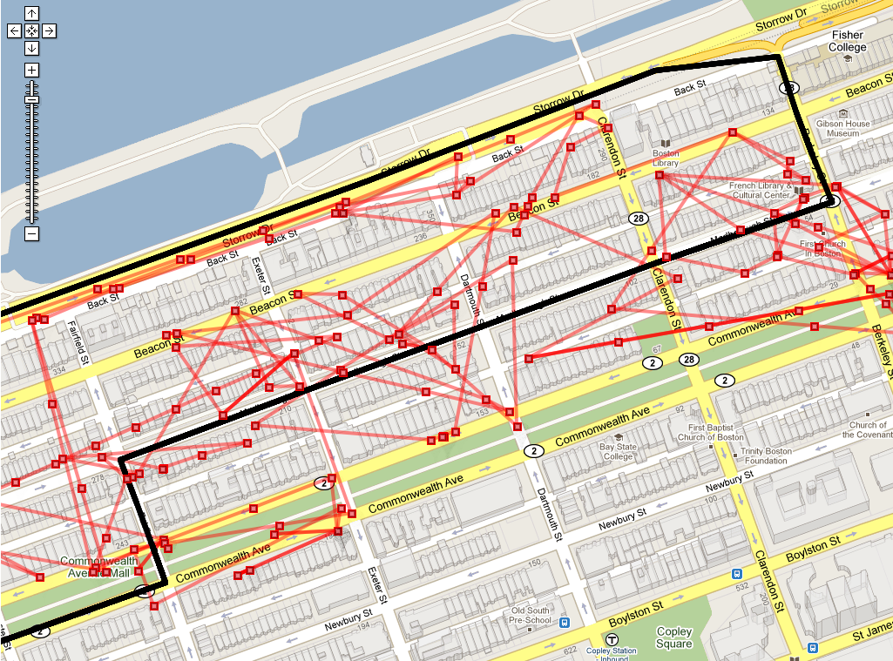
Existing Cellular Location Systems Aren’t Good Enough To Find Tracks
State-of-the-art is “radio fingerprinting”
(E.g. PlaceLab)
OK for best static localization estimate
But poor at identifying tracks
Notes:
Slide 13: why is this hard? GSM is terribly hard to match… show Placelab results.

Slide 22
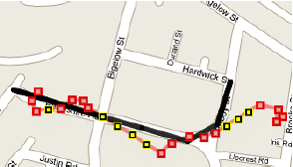
Existing Map-Matching Algorithms Perform Poorly w/ Cellular Radios
d8:30:62:5f:be:da, RSSI -94
00:0f:b5:3d:43:20, RSSI -58
00:18:0a:30:00:a3, RSSI -51
. . . . . . . . . . . . . .
42.361,-71.09
42.361,-71.09
42.362,-71.091
. . . . . . . .
42.361,-71.09
42.361,-71.09
42.362,-71.091
. . . . . . . .
Krumm et al. (SAE World Congress ‘07), VTrack (SenSys ‘09)
Notes:
Add picture showing Vtrack applied to Placelab.

Slide 23
Existing Map-Matching Algorithms Ok For GPS/WiFi, But Poor For GSM
d8:30:62:5f:be:da, RSSI -94
00:0f:b5:3d:43:20, RSSI -58
00:18:0a:30:00:a3, RSSI -51
. . . . . . . . . . . . . .
42.361,-71.09
42.361,-71.09
42.362,-71.091
. . . . . . . .
42.361,-71.09
42.361,-71.09
42.362,-71.091
. . . . . . . .
Krumm et al. (SAE World Congress ‘07), VTrack (SenSys ‘09)
Notes:
Slide 13: why is this hard? GSM is terribly hard to match… show Placelab results.

Slide 24
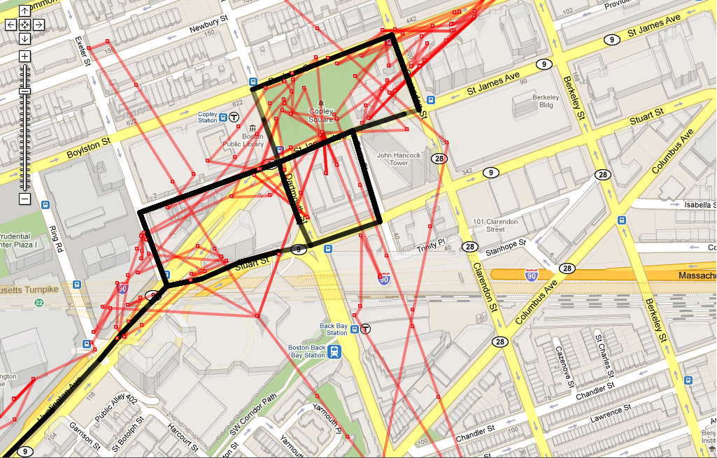
Notes:
Soft decision decoding: draw analogy. Start with

Slide 25
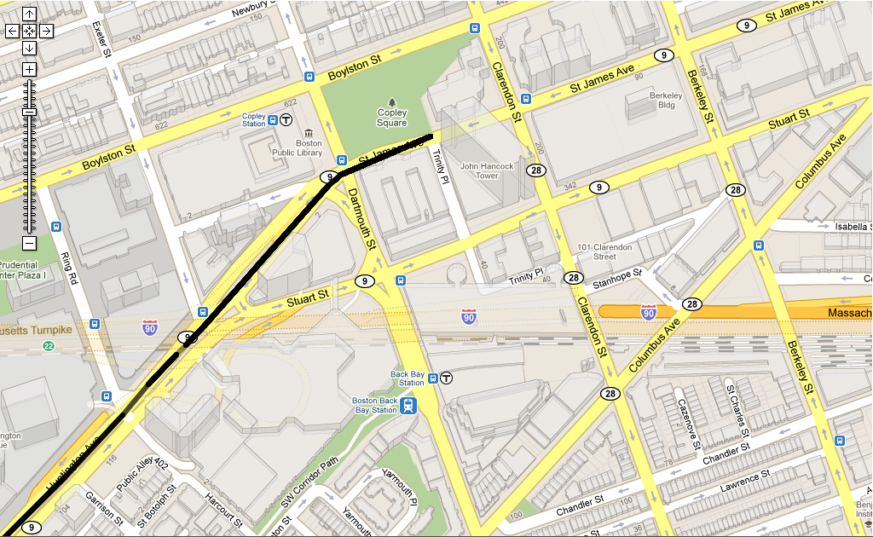
Notes:
Soft decision decoding: draw analogy. Start with

Slide 26
Key Insight in CTrack
Do not convert radio fingerprints to (lat, lon) coordinates and then sequence them on map
Instead, first sequence GSM fingerprints on a spatial grid
This insight is crucial: it reduces error by 3x
Notes:
Soft decision decoding: draw analogy. Start with

Slide 27
CTrack FlowChart
Input Track

Slide 28
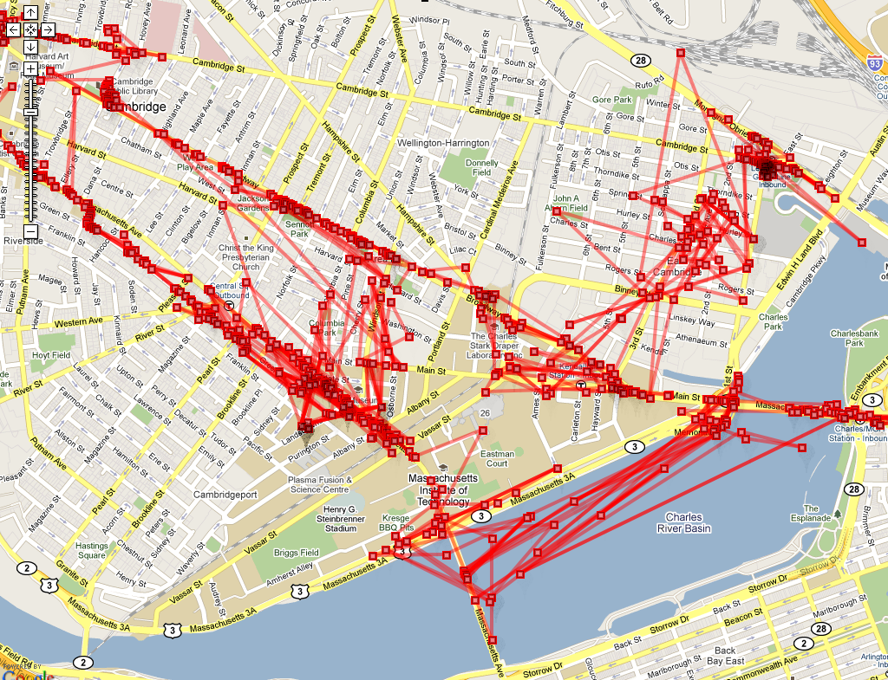
Raw points (Placelab)
Notes:
Soft decision decoding: draw analogy. Start with

Slide 29
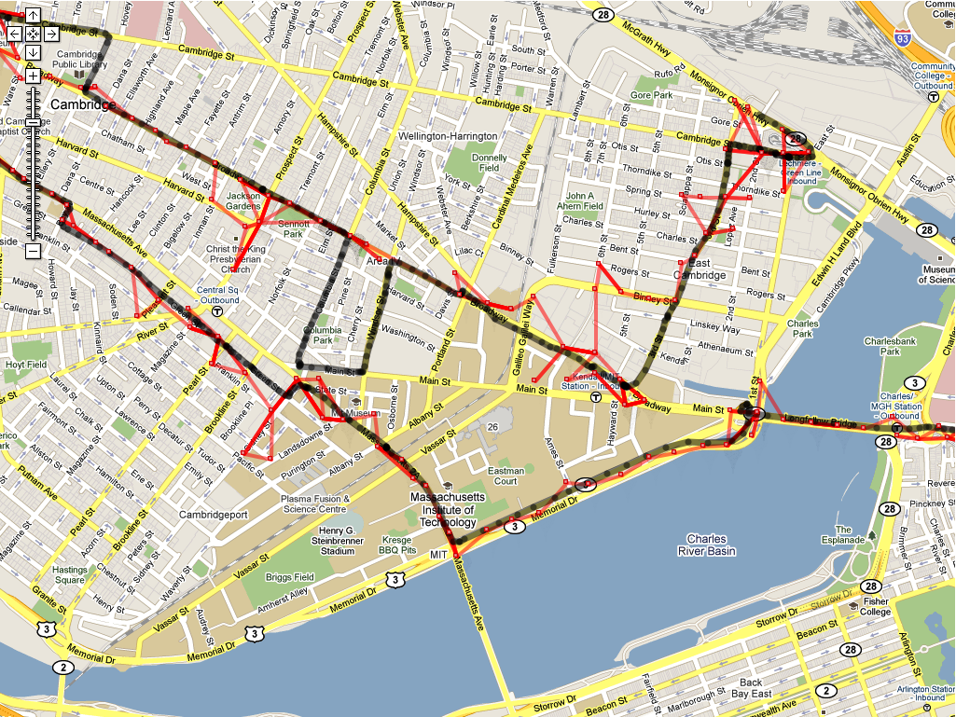
Grid Sequence
Notes:
Soft decision decoding: draw analogy. Start with

Slide 30
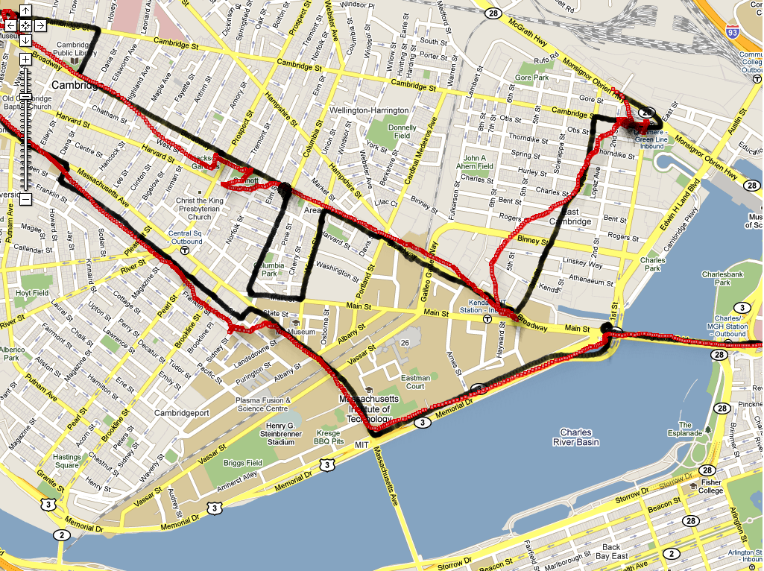
Smooth + Interpolate Grid Sequence
Notes:
Soft decision decoding: draw analogy. Start with

Slide 31
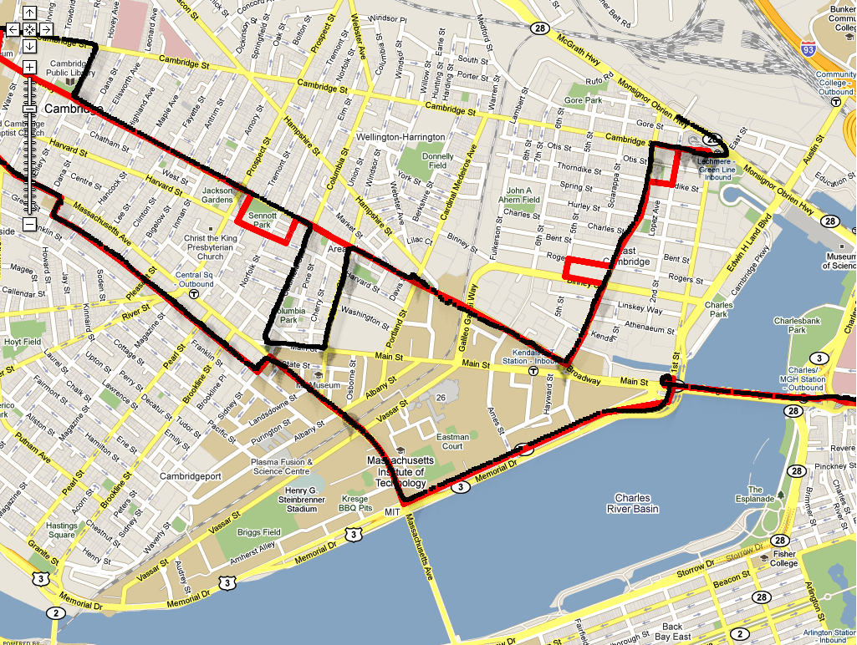
Smoothed Grid → Road Segments
Notes:
Soft decision decoding: draw analogy. Start with

Slide 32
CTrack Steps
HMM fingerprints to grid sequence
Raw points (placelab)
Smooth + interpolate grid sequence
HMM smooth grid to map
Notes:
I haven’t shown the grid lines here, they are kind of hard to see. Overlay grid on to second picture.

Slide 33
Grid Sequencing
Time TowerId RSSI
18.03 334490560 14
334478599 12
337772865 18
334478600 14
334470539 12
334490699 12
19.01 . . . . .
Size of grid = 125 meters
Why?
Given a sequence of GSM fingerprints (TowerID, RSSI),
what is the most likely sequence of grid cells?

Slide 34
HMM For Grid Sequencing
GSM Signature
(Towers+ RSSI)
“Observable”
Grid Cell
(“Hidden
State”)
334490560,14
334478599,12
337772865,18
Grid Cell
Grid Cell
Emission Score
P ( Signature| Grid Cell )
Grid Cell
Grid Cell
Grid Cell

Slide 35
HMM For Grid Sequencing
GSM Signature
(Towers+ RSSI)
“Observable”
Grid Cell
(“Hidden
State”)
334490560,14
334478599,12
337772865,18
Grid Cell
Grid Cell
Emission Score
P ( Signature| Grid Cell )
Transition Score
P ( Grid Cell | Previous Grid Cell )
Grid Cell
Grid Cell
Grid Cell
Dynamic Programming Finds Best Grid Sequence (cf. Viterbi)
“Best” => Max (Emission Score * Transition Score)

Slide 36
Emission Score (Grid Cell G, Fingerprint F)
F
Find closest matching fingerprint F_{closest} to F in all training data for grid cell G
Score is inversely proportional to “distance” d of F_{closest} from F in signal strength space
Better match => smaller d => higher score
Training Points
334490560,14
334478599,12
337772865,18
d
334490560,14
334478599,12
337772865,18
332231024, 7
F_{closest}
Notes:
We’re going to do it for every grid cell. Let’s consider one grid cell (animate it in). We have a set of training points
Each with their own fingerprint. We use the HMM to pick the sequence of grid cells. We don’t have to compute
scores for each grid cell – we use a pruning techninque.

Slide 37
Example
3344,13
3346,15
3347,12
3344,14
3346,12
3349,10
d = λ*2 + (d_{max}– 0.5*sqrt( (14–13)² + (12–15) ²)
With λ=3 and d_{max}= 32,
Emission Score =38 – sqrt(10)/2
Normalize this to (0,1] range

Slide 38
Tolerant Transition Score
Inversely proportional to
distance between grid cells
The score is very tolerant of jumps between non-adjacent grid cells
Necessary to tolerate large outliers/regions of poor coverage in the GSM data
d
Score = 1/d

Slide 39
Example
d = 7
Transition Score = 1/7
Transition Score = 1

Slide 40
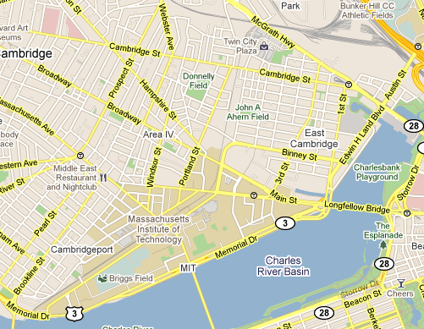
Grid Sequencing In Action

Slide 41
Grid Sequencing In Action

Slide 42
Grid Sequencing In Action

Slide 44
Smoothing & Interpolation

Slide 45
CTrack FlowChart
Input Track

Slide 46
Matching (Lat, Lon) To Segments
Latitude + Longitude
“Observable”
Road
Segment
42.361117,
-71.090203
Transition Score
P ( Road Segment | Previous Road Segment )
Latitude + Longitude
“Observable”
Road
Segment
42.361118,
-71.09021
Notes:
Emission Score is a gaussian error model on (lat, lon). Define the HMM first…
In VTrack, the observables is (lat, lon) and the *output is road segments*. Replace
With another HMM picture. Animate in the hints.

Slide 47
Matching (Lat, Lon) To Segments
Latitude + Longitude
“Observable”
Road
Segment
42.361117,
-71.090203
Transition Score
P ( Road Segment | Previous Road Segment )
Multiply by:
P(Movement | Movement Hint)
P(Turn | Turn Hint)
Latitude + Longitude
“Observable”
Road
Segment
42.361118,
-71.09021
Extract 0/1 (Binary) Movement and Turn Hints For Each Time Slot
Notes:
Emission Score is a gaussian error model on (lat, lon). Define the HMM first…
In VTrack, the observables is (lat, lon) and the *output is road segments*. Replace
With another HMM picture. Animate in the hints.

Slide 48
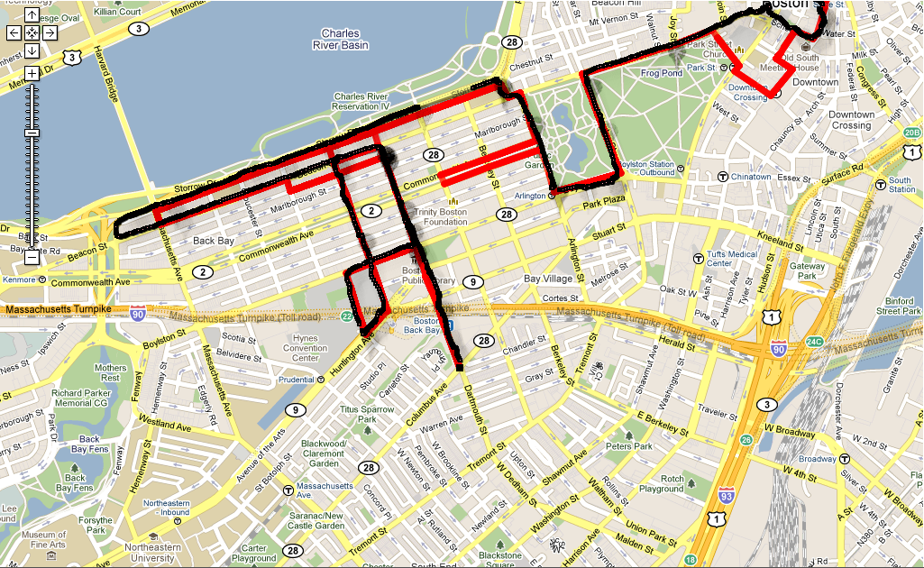
Notes:
Don’t switch color.

Slide 49
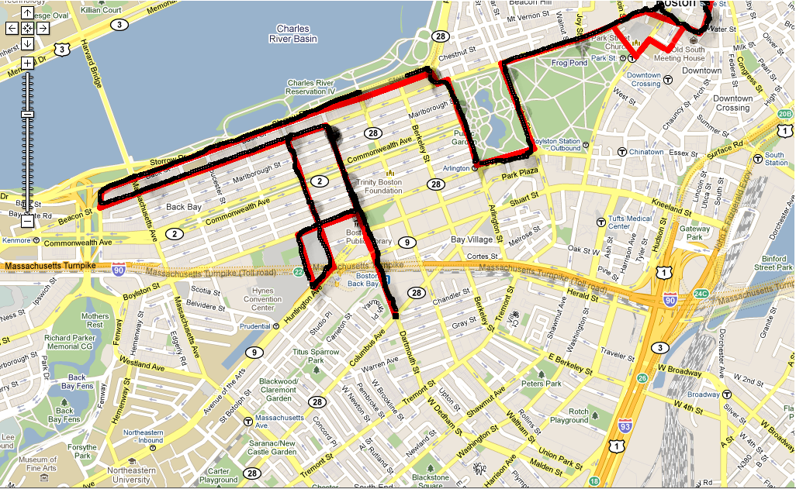
Notes:
Don’t switch color.

Slide 50
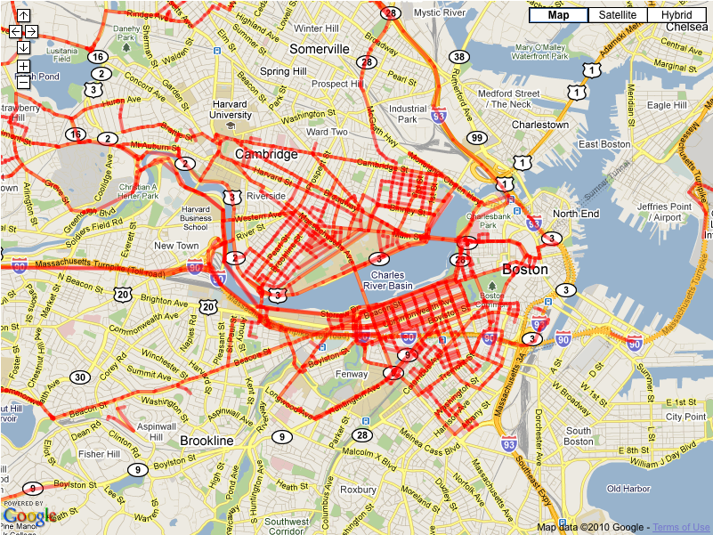
Evaluation
125 Hours (312 “Drives”)
From 16 Android phones
Logged GPS ground truth, GSM, accel, compass
Selected subset of 53 drives (28 hours) as “test drives”
Tests lie in dense cov. area
Tests have good GPS accuracy
Mean drive length: 30-35 mins
Leave-one-out evaluation
Train on all but test, evaluate on test drive
Notes:
Each drive is around half an hour.

Slide 51
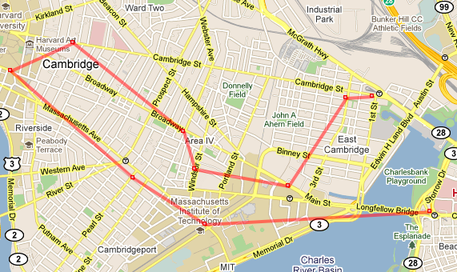
We Compared CTrack To…
Placelab + VTrack
Look up single best matching GSM fingerprint for each time
Match (lat, lon) using VTrack
GPS k + VTrack
Get a GPS sample every k secs
Match (lat, lon) using VTrack
k = 4 min is energy-equivalent to CTrack

Slide 52
Evaluation Metrics
Output Of Tracking Algorithm
Ground Truth

Slide 53
Evaluation Metrics
Output Of Tracking Algorithm
Best Sequence Matching
(Computed using DP)
Ground Truth
Match Length
(d = 0)
d
Precision = Match Length / Output Length
Recall = Match Length / Ground Truth Length
Notes:
Match length is the section where the two tracks align perfectly. Say it in audio track.
Draw it as rectangular broken lines….

Slide 54
CTrack Has 75% Precision: 3x Less Error Than Placelab+VTrack, GPS k
Notes:
Show bar chart with medians.

Slide 55
CDF Of Recall

Slide 56
Grid Sequencing Step is Critical
Sequencing First Before Converting to (Lat, Lon)
Coordinates is Critical

Slide 57
Impact Of Sensor Hints
Small in quantitative terms
6% precision, 3% recall
But help correct some systematic errors
Turn hints fix “kinks” in output track
Movement hints fix “looping” in GSM signature
Makes sense to take advantage of hints when available
(i.e. on a smartphone) – they are free in terms of energy!

Slide 58
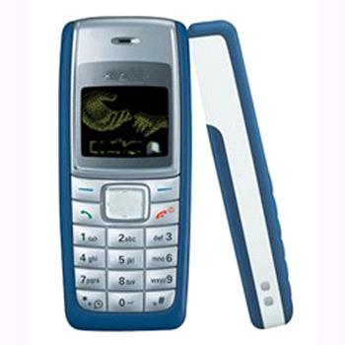
Conclusions
CTrack is a cellular-only system that:
Can recover over 75% of a user’s track
Significantly (over 3x) better in energy/accuracy tradeoff than existing approaches
Broader impact + future work:
Make large scale deployment of location-based apps feasible without running into energy barriers
Enable devices without GPS (85% of the market) to contribute to and benefit from location-based services

